Slide 1
Artificial Intelligence
Lecture 8 – Adversarial Search

Slide 2
MAEs and Games
Multi-agent environment: every agent needs to consider the actions of the other agents, in order to optimize its own welfare
  Normally considered in terms of economies
  Cooperative: Agents act collectively to achieve a common goal
  Competitive:
    Agents compete against each other
    Their goals are in conflict
    Gives rise to the concept of adversarial search problems – often known as games.

Slide 3
Game Theory
It’s a branch of economics
  Views any MAE as a game provided that the impact of each agent on the other is “significant”, i.e., able to affect the actions of the other agent(s)
In AI, “game” is a specialized concept:
  Deterministic, fully-observable environments
  Two agents whose actions must alternate
  Utility values at the end of the game are always equal and opposite
    +1 = Chess winner
    -1 = Chess looser.

Slide 4
AI Games
Tackled by Konrad Zuse, Claude Shannon, Norbert Wiener, Alan Turing
  Have seen lot of successes recently, e.g., DeepBlue
Game states are easy to represent:
Agents restricted by a limited action rules
Outcomes defined by precise rules
Games: interesting because they are hard to solve:
  Chess: average branching factor of 35
  If 50 moves by each player, search tree has 35¹⁰⁰ nodes!

Slide 5
Games vs. Search problems
In typical search problems, we optimize a measure to acquire the goal: there is no opponent
In games, there is an "Unpredictable" opponent
  Need to specify a move for every possible opponent reply
  Stringent time constraints
  Unlikely to find goal, must approximate
  Requires some type of a decision to move the search forward.
  Strict penalty on an inefficient move

Slide 6
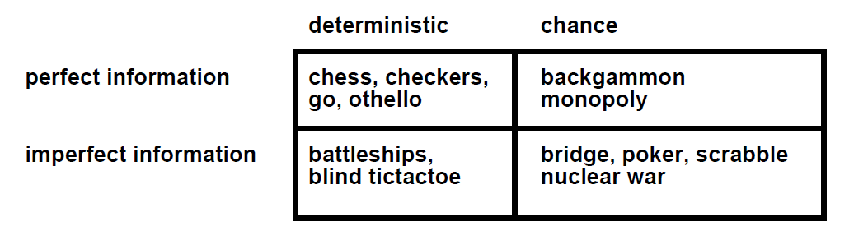
Types of Games

Slide 7
Game Formulation
Initial state
Successor function
Terminal state test
Utility function: defining the usefulness of the terminal states from the point of view of one of the players.
Imagine 2 players of tic-tac-toe: MAX and MIN
  MAX moves first: We can generate a game tree
  The terminal states are at the leaves
MAX should play in order to maximize its utility, which will minimize the utility for MIN
  This is called a Zero-Sum Game.

Slide 8

Game tree (2-player, deterministic, fully observable)
This terminal state is one of the worst for MAX and one of the best for MIN
This terminal state is one of the best for MAX and one of the worst for MIN

Slide 9
Optimal Strategy For MAX
This is a MAE
  In discovering the sequence of optimal moves by MAX, we have to consider that MIN is taking moves as well
  So, the optimal strategy will tell how should MAX play against MIN (by considering the moves of the latter), in order to win the game
Let us consider a shortened game tree of TIC-TAC-TOE
  Numbers are the utilities
  Ply: a move by MAX followed by a move from MIN.

Slide 10
Algorithms for Adversarial search
Minimax
Alpha Beta Pruning

Slide 11
Minimax
When it is the turn of MAX, it will always take an action in order to maximize its utility, because it’s winning configurations have high utilities
When it is the turn of MIN, it will always take an action in order to minimize its utility, because it’s winning configurations have low utilities
In order to implement this, we need to define a measure in each state that takes the move of the opponent into account:
  This measure is called Minimax.

Slide 12

Shortened Game Tree
Move of MAX
Move of MIN

Slide 13
Minimax
Minimax represents the utility of a state, given that both MAX and MIN will play optimally till the end of the game
In any state s, one or more actions are possible
For every possible new state that can be transited into from s, we compute the minimax value
The term “Minimax” is used because:
  the opponent is always trying to minimize the utility of the player, and
  the player is always trying to maximize this minimized selection of the opponent.
Confused? See next slide…

Slide 14
Minimax
Consider “3” at Level 1: MIN selects an action (A11) that leads to a state of minimum utility for MAX, i.e., minimum{3,12,8}
Consider “3” at Level 0: MAX selects an action (A1) that leads to a state of maximum utility for MIN, i.e., maximum{3,2,2}
  Both are opposing what is best for the other.

Slide 15
Minimax
At each node, MAX will always select the action with highest minimax value (it wants to reach states with higher utilities)
At each node, MIN will always select the action with lowest minimax value (it wants to reach states with lower utilities).

Slide 16

Minimax algorithm
Depth-First Exploration
Recursion: Winds all the way to the terminal nodes, and then unwinds back by backing up the values
Min(minimax) for MIN moves
Max(minimax) for MAX moves

Slide 17
Properties of Minimax
Complete? Yes (if tree is finite)
Optimal? Yes (against an optimal opponent)
Time complexity? O(b^{m})
Space complexity? O(bm) (depth-first exploration)
For chess, b ≈ 35, m ≈100 for "reasonable" games → exact solution completely infeasible
  We need to think of a way to cut down the number of search paths.

Slide 18
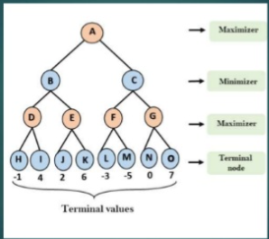
Practice Question

Slide 19
Alpha Beta Pruning
Cut off search by exploring less number of nodes.
If any node satisfies the condition that is (α >=β) then that node will be pruned.
Searching order is DFS.
α is Max and β is Min.
16 September 2020

Slide 20

α-β pruning example

Slide 21

α-β pruning example

Slide 22

α-β pruning example

Slide 23

α-β pruning example

Slide 24

α-β pruning example

Slide 25

Why is it called α-β?
α is the value of the best (i.e., highest-value) choice found so far at any choice point along the path for MAX
If v is worse than α, MAX will avoid it
  → prune that branch
Define β similarly for MIN.

Slide 26


The α-β algorithm

Slide 27
Properties of α-β
Pruning does not affect final result
Good move ordering improves effectiveness of pruning
With "perfect ordering," time complexity = O(b^{m/2})
  → doubles depth of search
A simple example of the value of reasoning about which computations are relevant (a form of meta-reasoning)

Slide 28

Questions

